Slide 1

Sprint 3: Scooter Rental System

Slide 2

CONTENTS
01
Opening & Overview
02
Sprint 3 Goals & Achievements
03
System Architecture
04
UI & Development Process
05
Challenges & Future Plans
06
Closing

Slide 3

01
Opening & Overview

Slide 4

Sprint 3 Presentation Kickoff
Presentation Scope
Today we present our Sprint 3 progress for the Scooter Rental System, covering achievements, development methodology, and upcoming plans for the next sprint cycle.
Session Agenda
We will walk through frontend deliverables, system architecture decisions, challenges encountered, and our roadmap toward full system completion in Sprint 4.

Slide 5
Project Overview and Tech Stack
02
01
03
Core Functions
User registration and login, scooter catalog browsing, and a complete booking reservation system form the functional backbone.
System Purpose
Technology Stack
A web-based scooter rental platform enabling users to browse, book, and manage rentals online with convenience and efficiency.
Vue 3 with Vite powers the frontend, Pinia manages state, Vue Router handles navigation, with Node.js backend planned.

Slide 6
02
Sprint 3 Goals & Achievements

Slide 7
Sprint 3 Objectives Defined
Frontend Structure
Routing & State
Build a complete, modular frontend codebase ready for scaling and backend integration.
Set up Vue Router navigation and Pinia state management for seamless user experience.
Core Pages
API Readiness
Implement Home, Login, and Booking pages as primary user-facing interfaces.
Prepare API layer structure so frontend can operate independently until backend is ready.

Slide 8
Functional Achievements Completed
01
02
Deliverables Completed
System Status
Home Page, Login & Register Page, Booking Page, Vue Router navigation, and Pinia state management are all fully implemented and operational.
The frontend system is now fully functional with all pages connected, routes protected, and state flowing correctly across the application.

Slide 9
03
System Architecture

Slide 10
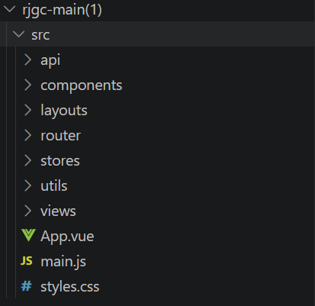
Project Structure Visualization
Screenshot Placeholder

Slide 11

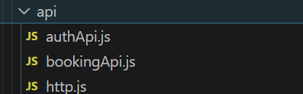
Modular System Architecture Design
Components & Views
API Layer
Reusable UI components and page-level views separate concerns and promote code reuse across the application.
Router & Store
Vue Router controls navigation flow while Pinia Store manages global application state consistently.

Slide 12



“
API Folder Structure Display
Screenshot Placeholder
[INSERT SCREENSHOT: api folder structure showing authApi and bookingApi files. Purpose: illustrate backend integration preparation and forward-planning for authentication and reservation endpoints.]
“

Slide 13

API Preparation for Integration
Prepared Interfaces
User authentication API and booking API structures are fully designed with endpoint definitions, request formats, and expected response schemas ready.
Integration Readiness
Frontend requires no structural changes later; backend can plug into existing API layer seamlessly when development completes.

Slide 14
04
UI & Development Process

Slide 15
Main UI Pages Completed
01
02
03
Home Page
Login Page
Booking Page
Serves as the system entry point with clear navigation and overview of available scooters.
Provides secure user authentication interface with form validation and error handling.
Enables scooter reservation with date selection, availability check, and confirmation flow.

Slide 16
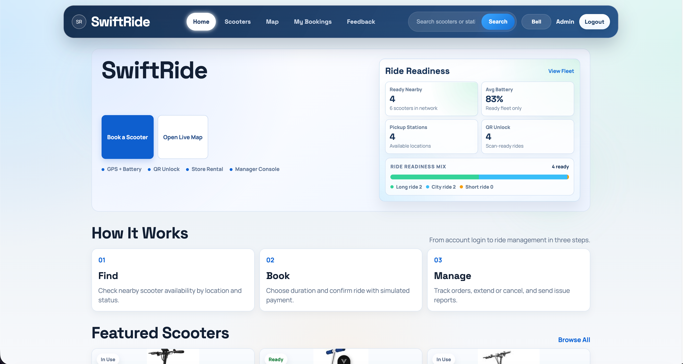
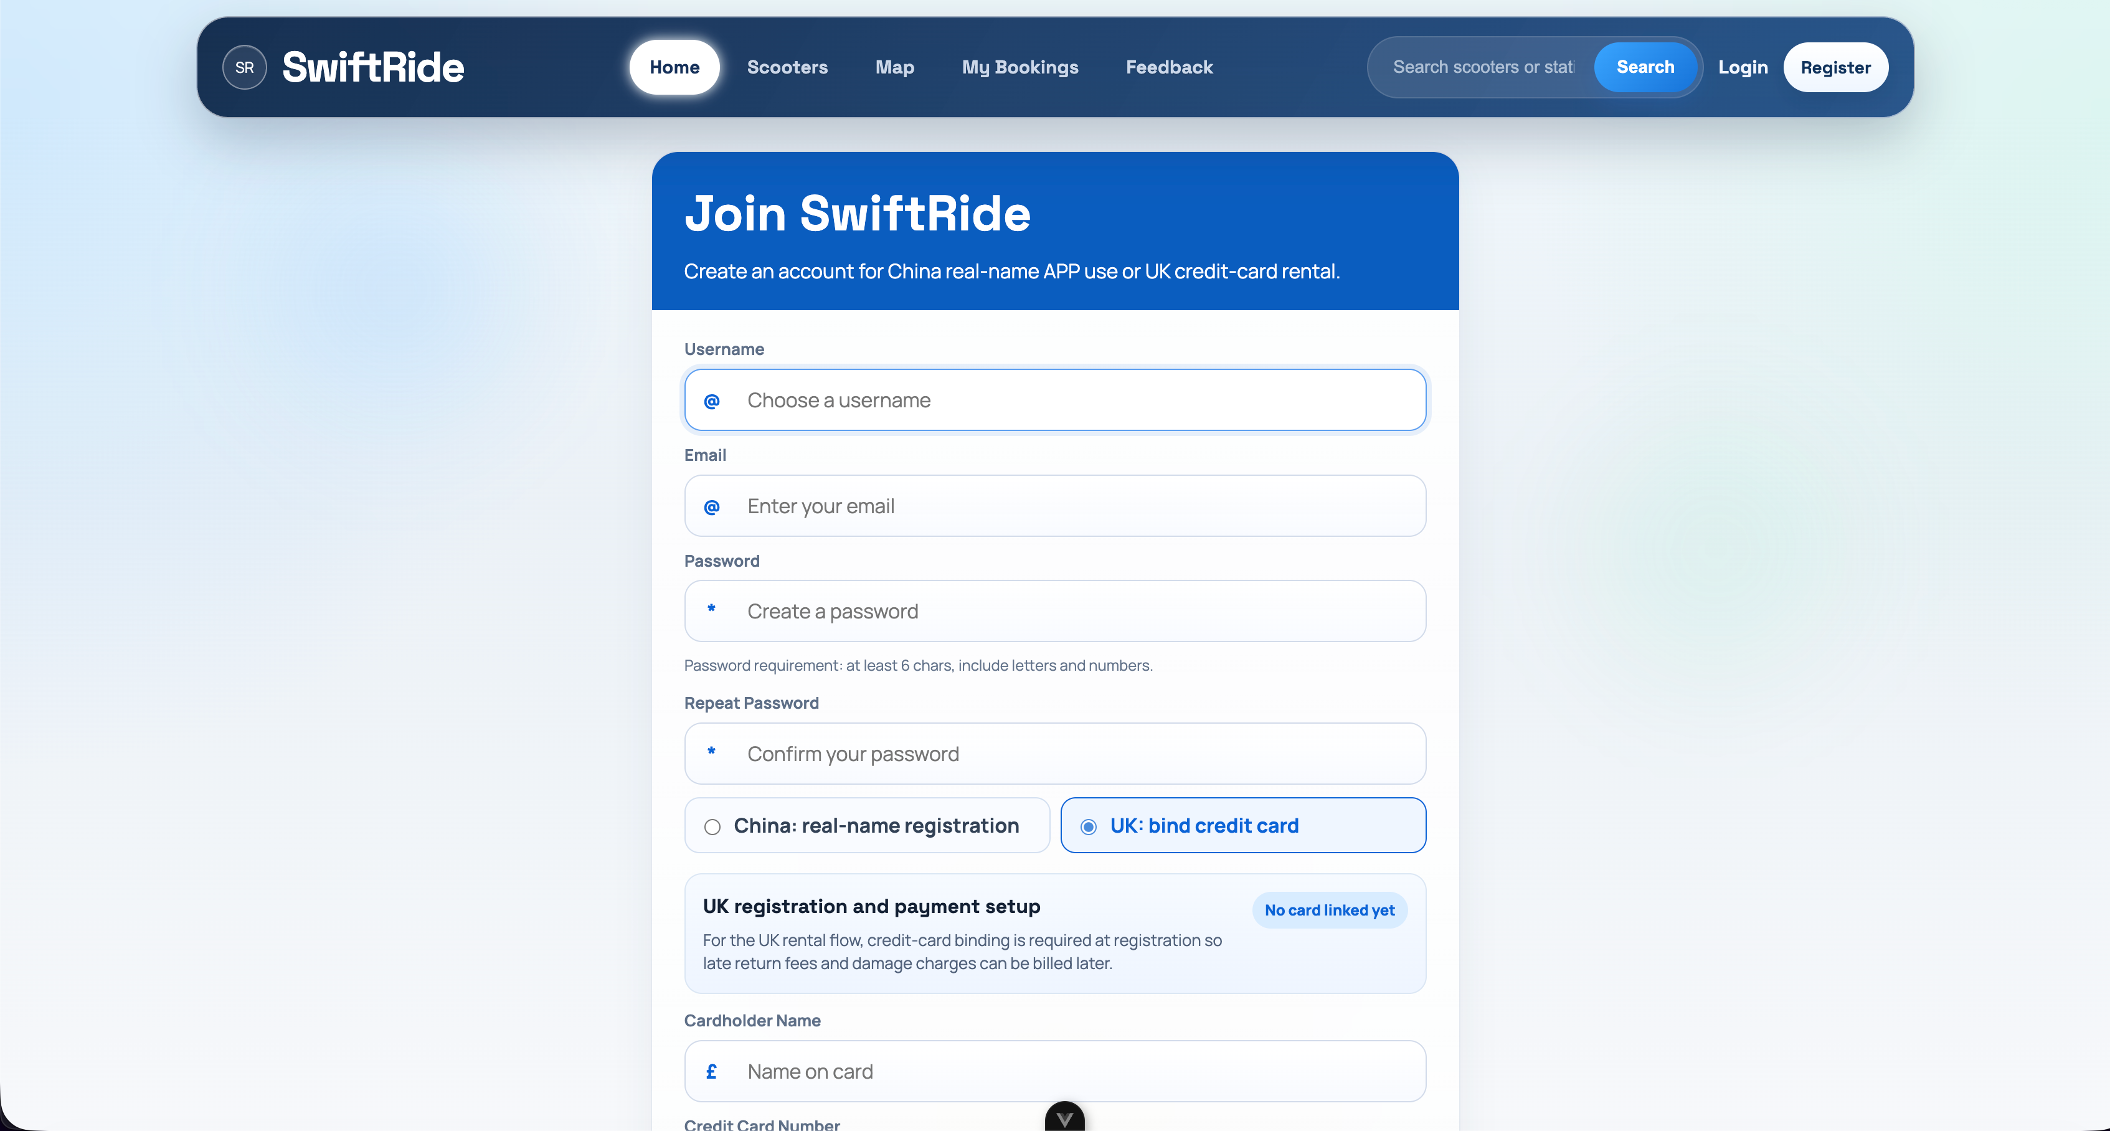
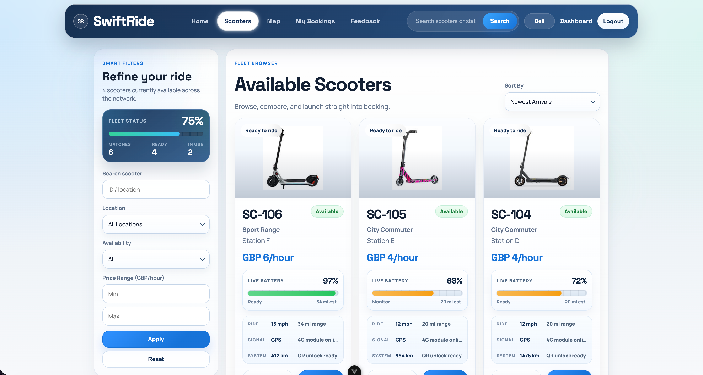
“
UI Screenshots User Flow Demo
HOME
LOGIN
“
BOOKING

Slide 17
Agile Development Process Followed
Backlog Planning
Version Control
Tasks prioritized and tracked through sprint backlog for focused feature delivery.
GitHub manages code history, branching, and collaborative merges across the team.
Feature Development
Quality Assurance
Incremental feature-based coding ensures each component is complete before moving forward.
Weekly meetings and continuous testing catch issues early and maintain stability.

Slide 18
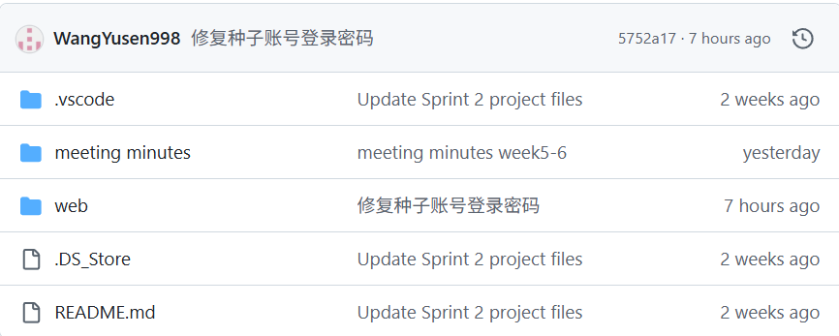
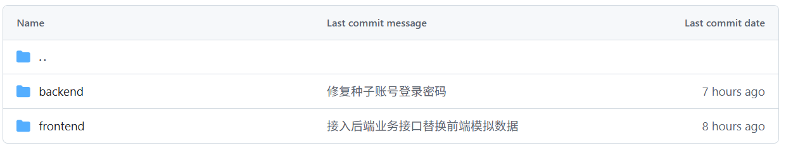
GitHub Commit History Evidence
Screenshot Placeholder

Slide 19
05
Challenges & Future Plans

Slide 20

Challenges Faced and Solutions Applied
Key Challenges
Applied Solutions
Backend was unavailable during frontend development, and API integration could not be tested live, creating dependency risks for the sprint timeline.
We designed API contracts in advance, developed frontend independently with mock data, and scheduled full integration for Sprint 4 to maintain velocity.

Slide 21

Backend & Database
Develop Node.js backend services and establish database connections for persistent data storage.
Sprint 4 Plan for Full Completion
Integration & Auth
Connect frontend APIs, implement authentication system, and build payment processing module.
Testing & Docs
Execute full system testing and finalize technical documentation for project delivery.

Slide 22
06
Meeting Notes

Slide 23
Meeting Minutes & Action Plan
Key Decisions & Improvements
Action Items
Task | Assignee | Deadline
Add real scooter images to UI | Zhang Rui peng | 2026-04-28
Unify UI language to English | Zhao Zishuo | 2026-04-28
Implement GPS & Battery simulation | Wang Yusen | 2026-04-28
Improve rental business logic | Liu Yutong | 2026-04-28
Add safety disclaimer & legal info | Feng Junda | 2026-04-28
Language Consistency: Unify all UI text to English to ensure a consistent user experience.
Visual Authenticity: Replace placeholder images with real scooter photos and implement image zooming features.
Business Logic: Enhance the "dockless" model by adding GPS tracking simulation, battery monitoring, and fine calculation logic.
Compliance: Add insurance explanations and liability disclaimers to improve system legality.

Slide 24
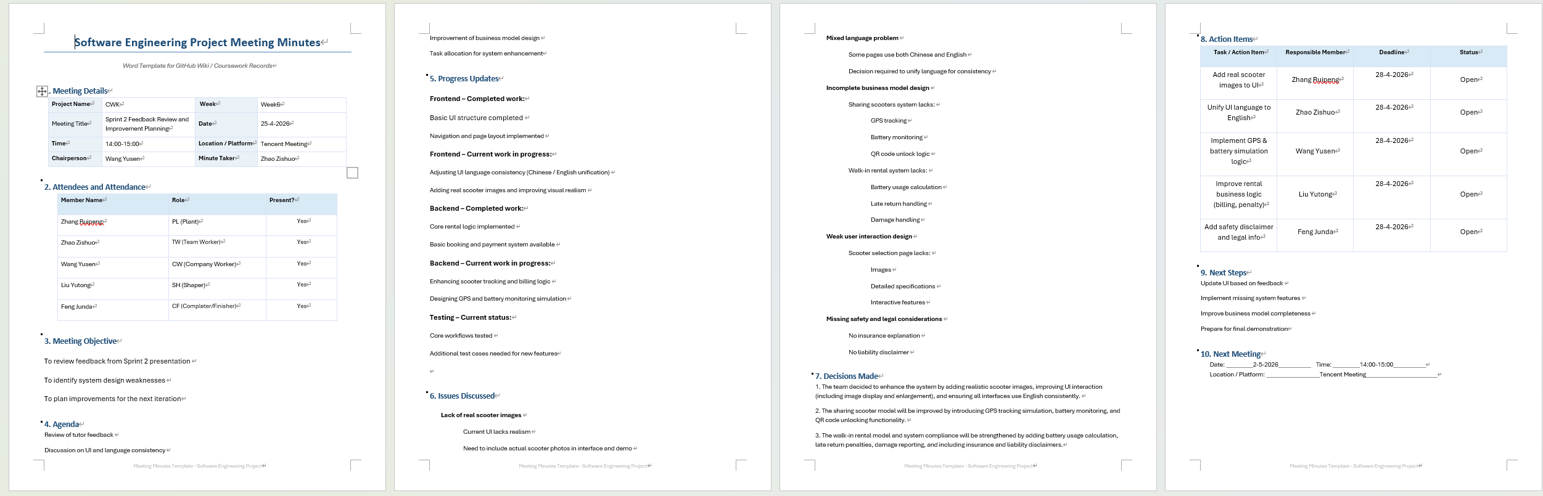
Meeting notes

Slide 25
07
Closing

Slide 26

Sprint 3 Achievements Summary
Frontend Complete
All user-facing pages are built, routed, and state-managed for immediate use.
Architecture Clean
Integration Ready
Modular folder structure and component design ensure long-term maintainability.
API layer prepared so backend development can commence without frontend rework.

Slide 27

Thank You and Q&A Invitation
Closing Remarks
Thank you for your attention. We welcome any questions about our Sprint 3 progress, technical decisions, or plans for Sprint 4 completion.

Slide 28

THANK YOU

